Slide 1

Analyzing Car Sales Data: A Visual Exploration
Nigel Kaganzi

Slide 2
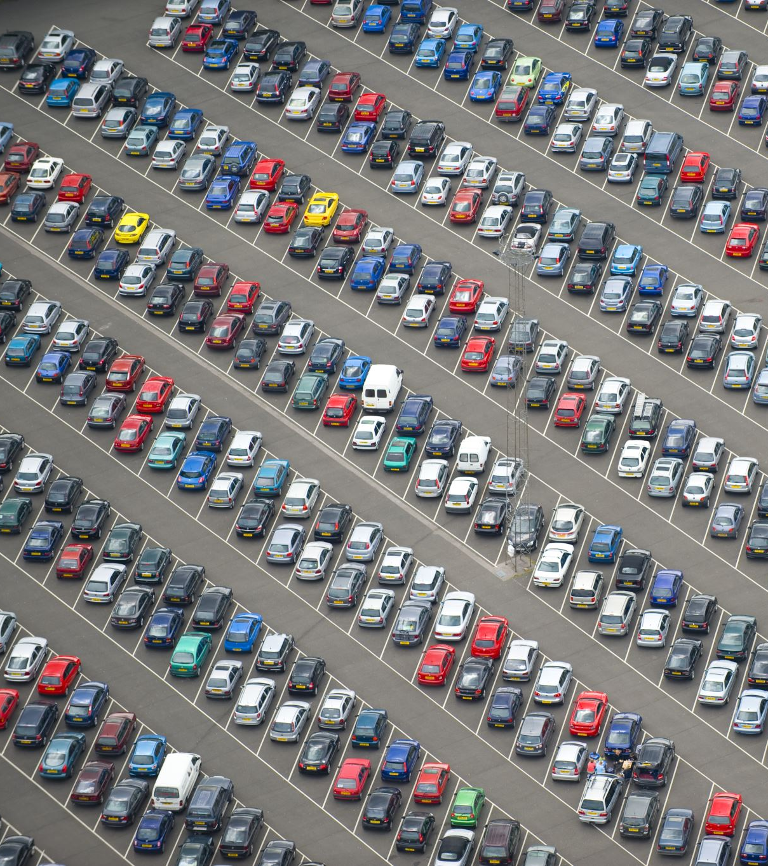
Project Overview
Car Sales Data set from Kaggle
- Number of cars sold:450,000+
- 2014-2015
- https://www.kaggle.com/datasets/syedanwarafridi/vehicle-sales-data

Slide 3
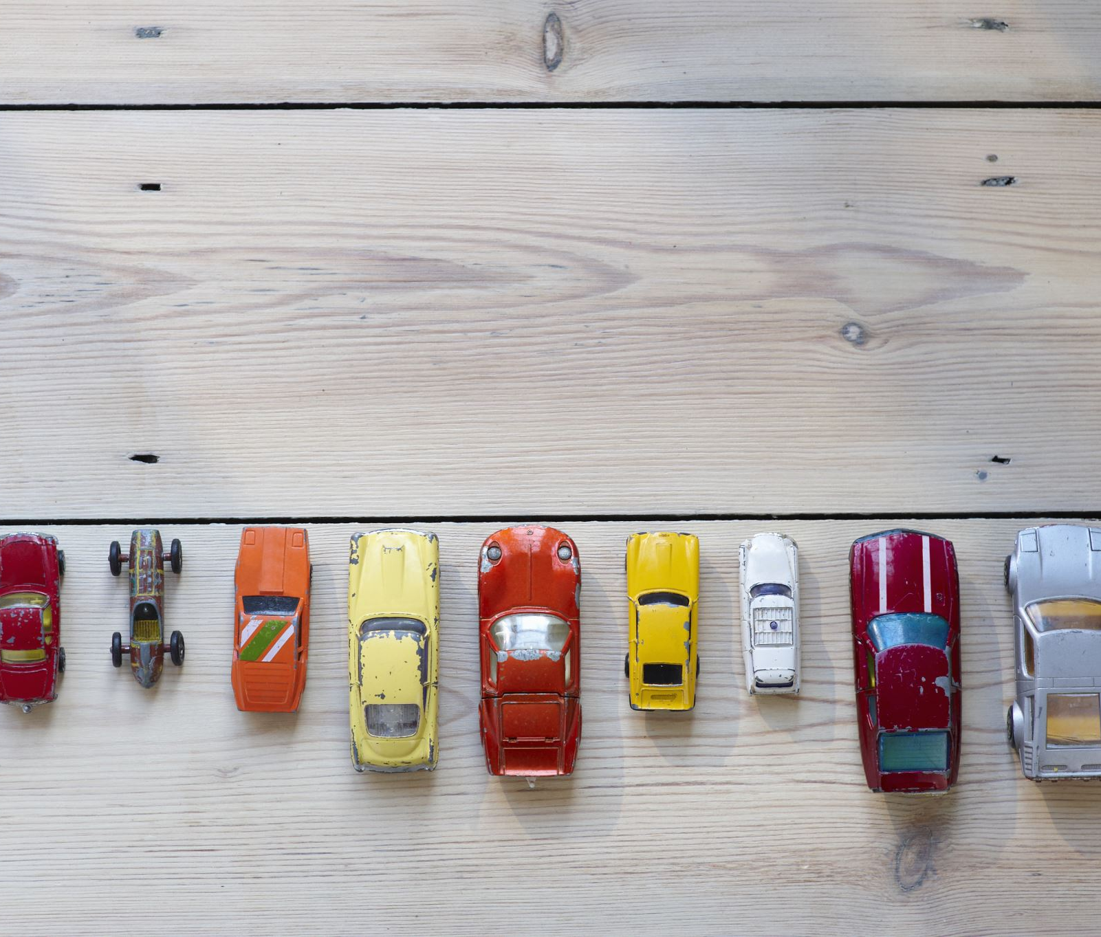
Sample Data Visualization Questions
How have car sales trended over time?
Where are the highest sales recorded geographically?
Which car models are the top sellers?
What is the difference in mmr and sale price?
Is there a season where people are buying more cars or no?

Slide 4
Types of Data Visualizations
- Line Charts: For showing the trend of car sales over time.
- Geographic Maps: For visualizing the distribution of car sales by location.
- Bar Charts: For comparing sales of different car models.
Pie charts: For showing percentage of sales by car make.

Slide 5

Data Visualization Design
Line charts with labels of high and low years.
Geographic Map with bubbles that show larger sales in those areas or darker colors for larger sales.
Interactive dashboard where you can pick a state or model and the whole dashboard will show you information based on your selection.

